Slide 1
A Global Media Outreach Ministry

Slide 2
Romans 10:17
“So then faith comes
by hearing, and hearing
by the word of God.”

Slide 3
TWR
Speaking Hope
to the World

Slide 4
Vision Statement
To reach the world for Christ
by mass media so that
lasting fruit is produced

Slide 5
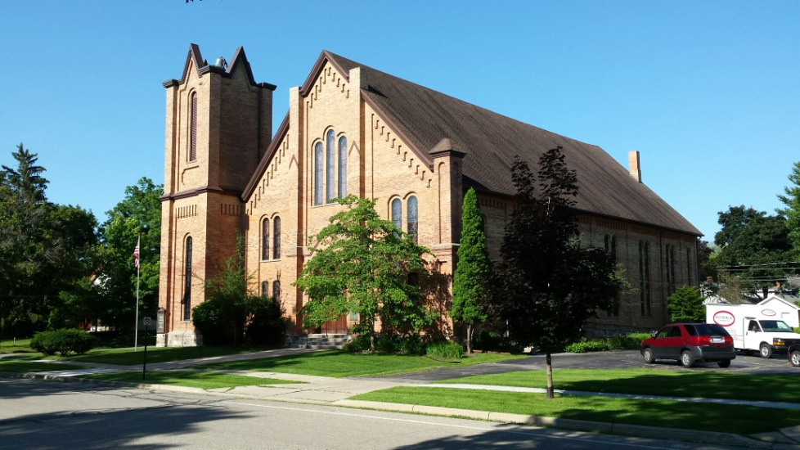
Our Mission
The purpose of Trans World Radio is
to assist the Church
to fulfill the command of Jesus Christ
to make disciples of all peoples,
and to do so by using mass media

Slide 6
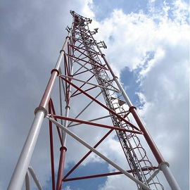
We proclaim the Gospel of
salvation to as many people
as possible.
We instruct believers in
biblical doctrine and daily
Christ-like living. We model our message through
our corporate and
cooperative relationships.

Slide 7
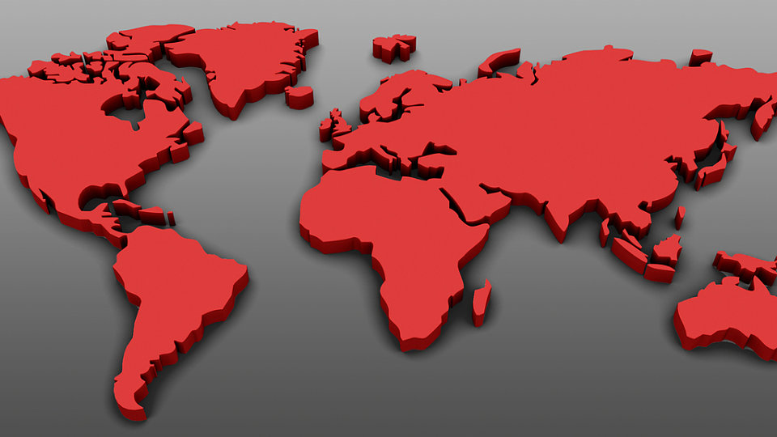
9 TWR Regions
Europe NE Asia
North America CAMENA (Muslim World)
West & South Asia
Central Africa SE Asia
Latin America
South & E. Africa

Slide 8
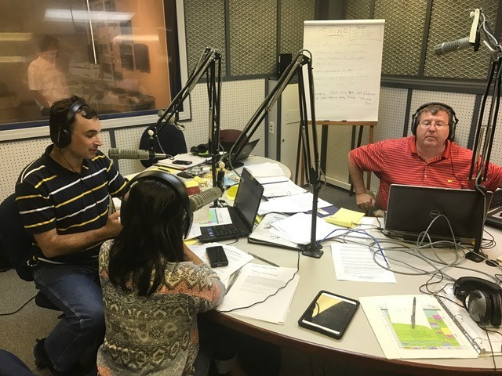
TWR has 70 National Partners
who provide the content
in 230 languages and conduct
all of the follow-up with people
who contact TWR

Slide 9
TWR delivers
the gospel message through…

Slide 10
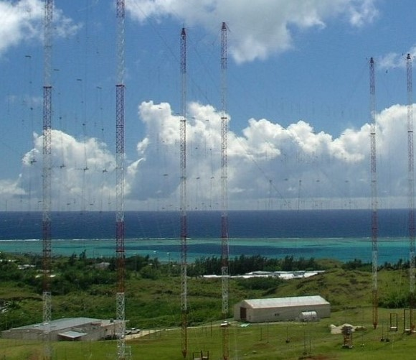
Radio
32 international broadcast sites on superpower AM and shortwave radio
Over 2000 local FM stations around the world
In 230+ languages
To listeners in 190 countries

Slide 11
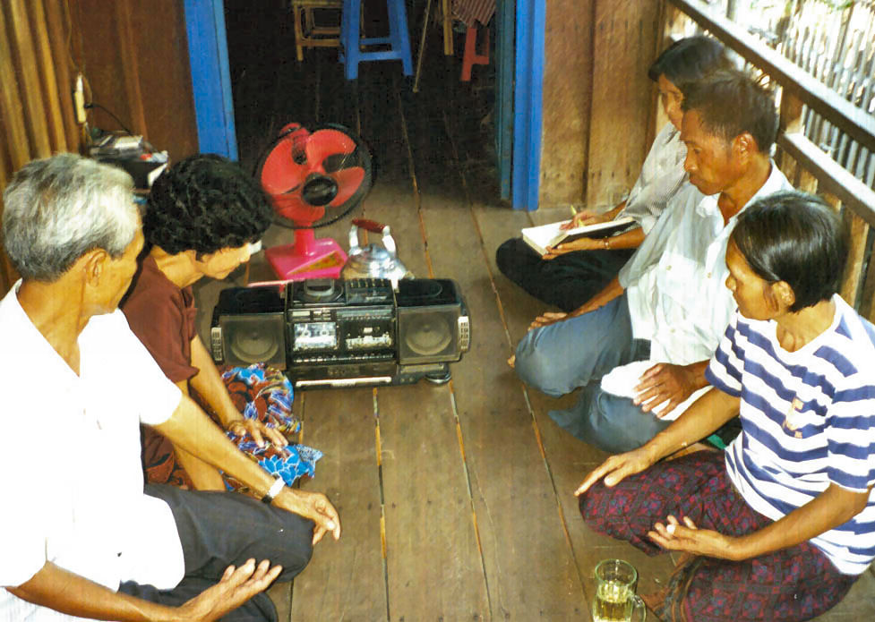
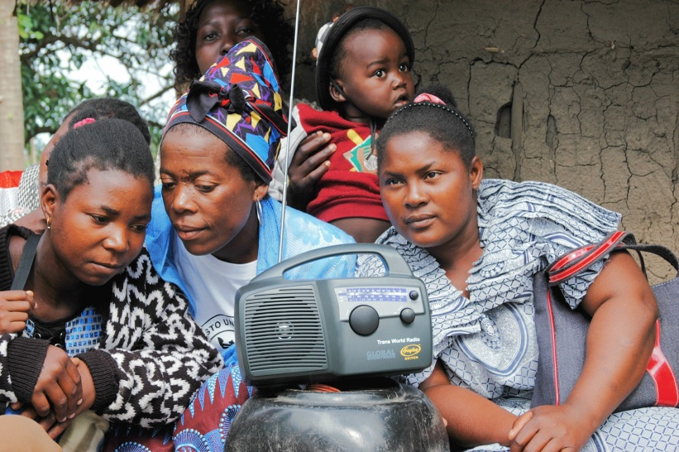
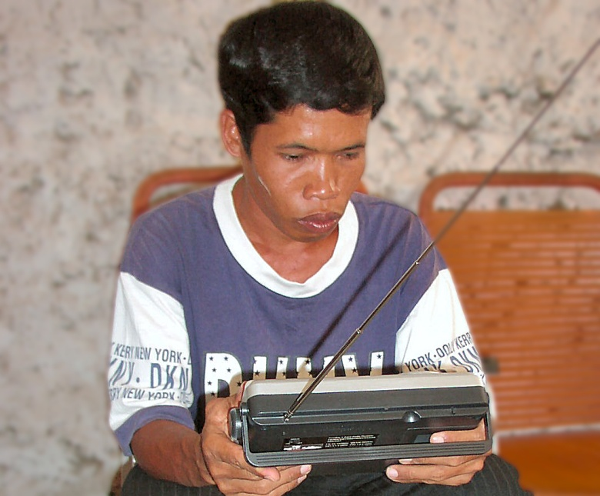
Worldwide, every day, 4 billion people can potentially hear the gospel on a TWR radio program in their heart language

Slide 12
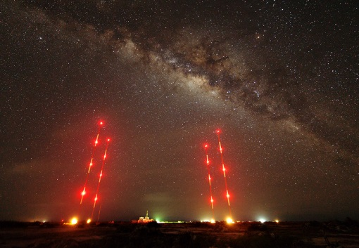
3 Levels of Teaching Ministry
Evangelism
Discipleship
Seminary training for
House-church pastors

Slide 13
How TWR Conducts Follow-up
Listeners download radio programs
TWR offices receive phone calls and texts
Letters and emails send out printed literature
Conduct in-person visits
Connect through social media

Slide 14
Media Distribution
Distribute radios & digital devices through the Radios for the World Project (TWR)
Follow-up workers send out Bibles and
New Testaments
Distribute and process Bible
Correspondence Courses

Slide 15
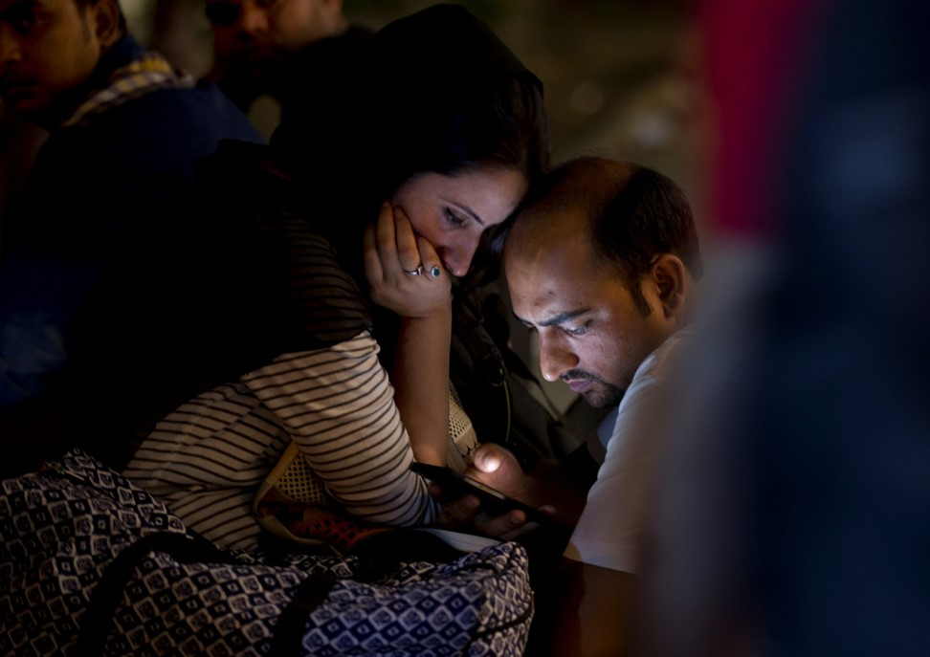
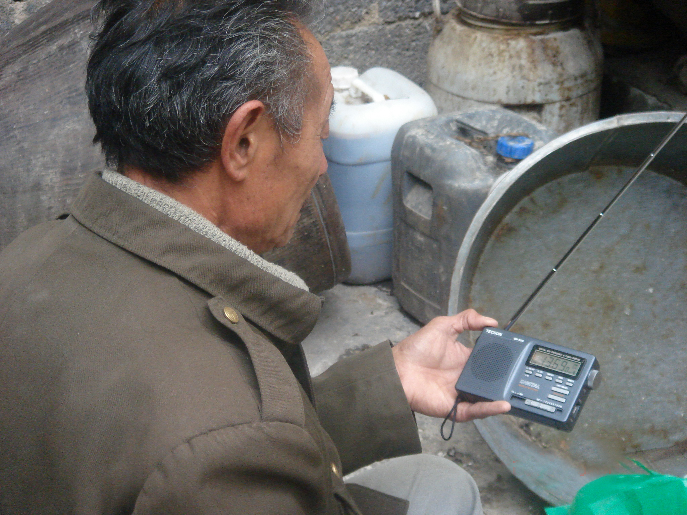
Listener responses
2016 = 18.5 million
2017 = 20.1 million
2018 = 28.2 million

Slide 16
Who is reached by digital media?

Slide 17
Millennials worldwide (under age 39)
Any computer or smartphone user
with internet access
Urban dwellers have more access to technology
The educated or people with money any culture

Slide 18
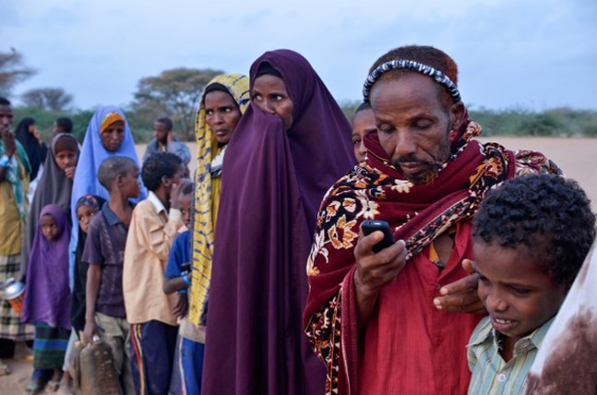
Growth of Internet Usage
Year Internet users % World
2005 1.03 billion 15.8
2.02 billion 29.2
3.18 billion 43.4
2019 4.39 billion 57.0
As of September 2019 the world population is 7.7 billion

Slide 19
The Future of the Internet
Amazon’s Project Kuiper plans 3,200 satellites.
8 other US companies have received FCC approval.
10 companies will have 15,000 satellites in orbit.
By 2030, the entire planet will have internet access.

Slide 20
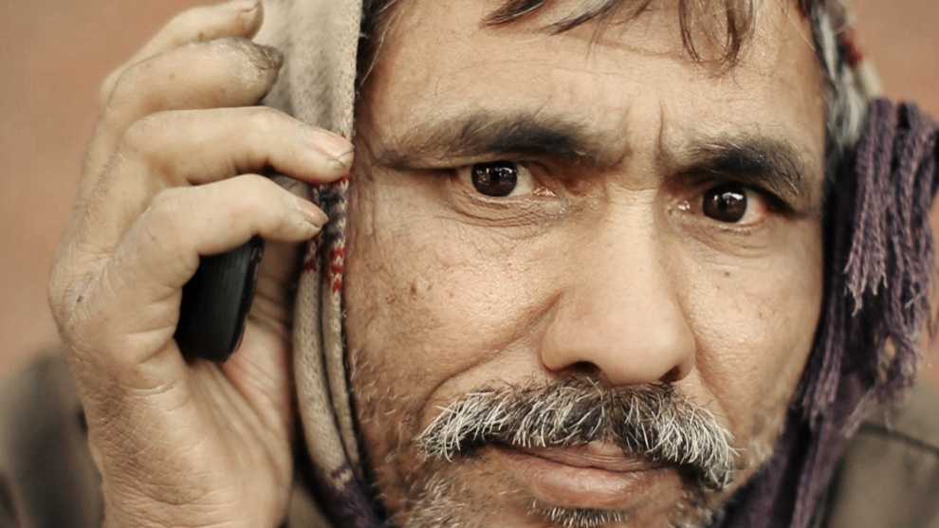
twr360 Internet Ministry
Makes Bible media available at any time, any place to any connected digital device.
Software reads the language of the browser accessing the site.
Over 70% of users access non-English content.

Slide 21
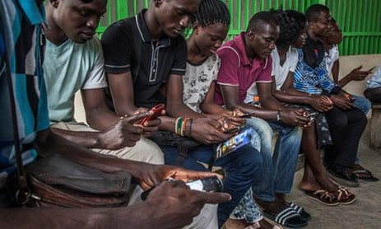
twr360 Response
Averaging over one million visits per month
From a monthly average of over 225 countries
16.4 million visitors in 2018

Slide 22
twr360.org
245 ministry partners produce
more than 800 programs
in 87 languages
that reach over
4 billion
in their heart language

Slide 23
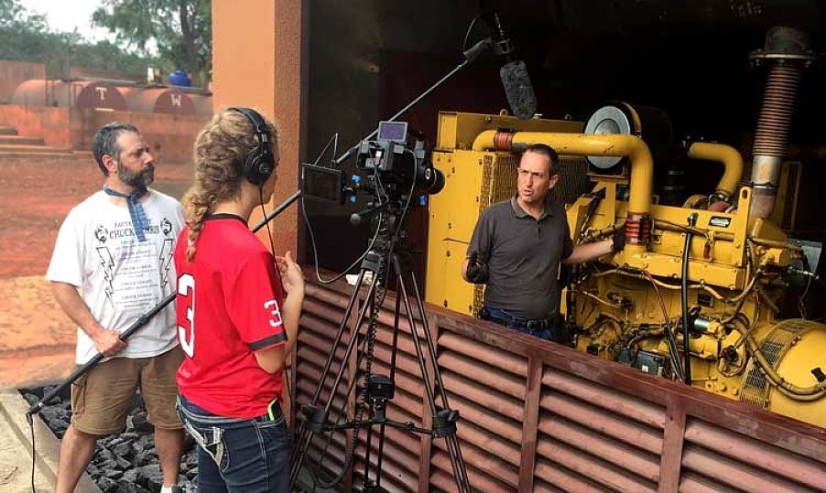
TWR Motion
TWR MOTION is our visual-media ministry.
The team has produced all TWR’s promotional and fundraising videos on its main website and for distribution

Slide 24
TWR MOTION creates video content to serve the church as they make disciples in areas with media access, but limited gospel resources.
Like many of the projects we work on, the MOTION team is working in sensitive areas

Slide 25
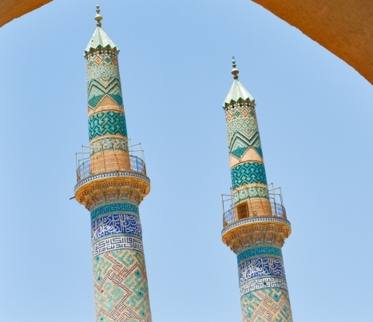
Their first major project produced a series of 20 animated Bible stories for North Africa
followed by a similar project in the Middle East.
They have plans to expand and translate these animated videos into multiple Arabic dialects.

Slide 26
TWR MOTION also equips other ministries
by providing research and strategies for cross-cultural evangelization.
We help these ministries create original video content that shares the gospel story with unreached people groups in their heart language.

Slide 27
TWR on the Move
2010 TWR installs two 250,000 watt digital transmitters on Guam to broadcast to China
2013 twr360 begins internet ministry in 6 major languages
2014 “PANI” transmitter goes on the air broadcasting the gospel to South Asia

Slide 28
TWR on the Move
2018
TWR Bonaire in Latin America expands to 450,000 watts
twr360 adds 26 languages
TWR MOTION targets Arab World on Internet with 20 animated Bible videos

Slide 29
TWR on the Move
2019
TWR installs “Oasis” transmitter in West Africa to broadcast to Nigeria
June 10th The 200,000 watt “Silk Road” transmitter in Central Asia starts broadcasting to Pakistan & Afghanistan

Slide 30
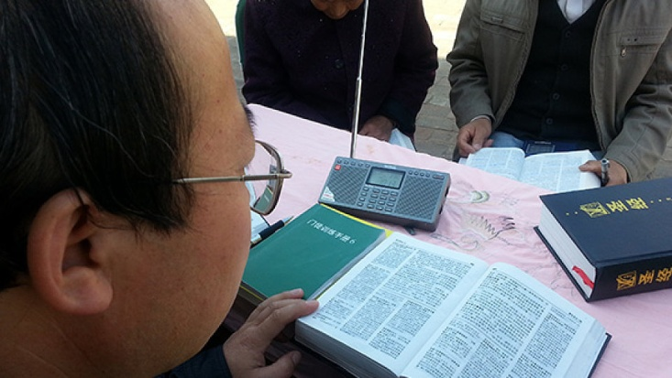
God is using TWR
to take multitudes of people
from doubt
…to decision
…to discipleship

