Slide 1



2021 AGM

Slide 2

Member Churches
47
46
45
42
38
36
32
22
2014
2015
2016
2017
2018
2019
2020
2021

Slide 3
Member Churches
YEAR | TASMANIAN CHURCHES
2012 | Hope Christian Centre
2014 | Margate Christian Church
2014 | Punchbowl Christian Centre
2015 | Boat Harbour Bible Church
2015 | Lighthouse Christian Fellowship
2015 | Oldaker Street Christian Centre
2015 | Romaine Park Christian Centre
2016 | Deloraine Gospel Chapel
2016 | Sheffield Bible Church
2018 | Scottsdale Assembly
2020 | Riverside Gospel Chapel
YEAR | REGIONAL VICTORIA CHURCHES
2014 | Christian Community Church Morwell
2014 | Community Church Warragul
2014 | Girgarre Christian Church
2014 | Discovery Community Church
2014 | Reach Out Seymour
2015 | Traralgon Family Fellowship
2016 | Numurkah Gospel Fellowship
2019 | Barfold Community Church
2019 | Living Waters Paynesville
2019 | Surf Church
YEAR | MELBOURNE CHURCHES
2014 | Balwyn Gospel Chapel
2014 | Canterbury Gardens Community Church
2014 | Eastleigh Community Church
2014 | Edge Church
2014 | Glen Hill Community Church
2014 | Grace Community Bible Church
2014 | Grace West Bible Church
2014 | Montmorency Community Church
2014 | Oakleigh Christian Fellowship
2014 | Ringwood Community Church
2014 | Christ Centred Community Church [C4]
2014 | Collaborate Church [ex Open House]
2014 | Warrandyte Community Church
2014 | Wattle Park Chapel
2015 | Ashwood Gospel Chapel
2015 | B3 Community Church
2015 | Compassion Centre
2017 | Southern Cross Church [SXC]
2017 | God’s Stuff
2018 | Crossroad Community Church
2018 | Abundant Grace Bible Church
2019 | Faith Alive Community Church
2021 | Way of Salvation
2021 | Hope Ignite Ministries
2021 | Hosanna Kingdom Praise
2021 | Grace Christian Community
Tasmania 11
Victoria 10
Melbourne 26
Total 47

Slide 4
NON-Member Churches
YEAR | TASMANIAN CHURCHES
1 | Eastern Shore Brethren
2 | Eastside Bible Chapel
3 | Elnathan Chapel
4 | Forest Edge Centre
5 | Hope Christian Church
6 | Middleton Christian Fellowship
7 | Midway Point
8 | Montague Community Church
9 | Newnham Christian Fellowship
10 | Ridgley Bible Chapel
11 | Riverside Gospel Chapel
12 | Snug Gospel Chapel
13 | Stanley Community Christian Church
14 | Ulverstone Gospel Chapel
YEAR | REGIONAL VICTORIA CHURCHES
1 | Bendigo South Gospel Chapel
2 | Fish Creek Assembly
3 | Gormandale Gospel Chapel
4 | Parkland Christian Chapel
5 | Peel Street - Ballarat
6 | Rutherglen Assembly
7 | Underbool Christian Assembly
YEAR | MELBOURNE CHURCHES
1 | Bayswater Christian Assembly
2 | Dandenong Gospel Chapel
3 | Glenroy Gospel Chapel
4 | Melbourne Indian Brethren Assembly
5 | Mooroolbark Christian Brethren Assembly
6 | Mulgrave Reserve Gospel Chapel
7 | Narre Warren North Christian Assembly
8 | Narrehills Family Church
9 | Nunawading Gospel Hall
10 | Pakenham Christian Assembly
11 | Sunshine North Gospel Hall
Tasmania 14
Victoria 7
Melbourne 11
Total 32

Slide 5

Church Plants
1 | Collaborate Church
 | Commenced 2012
2 | B3 Community Church
 | Commenced 2014
3 | Reach Out Seymour
 | Commenced 2015
4 | Compassion Centre
 | Commenced 2015
5 | Southern Cross Church
 | Commenced 2017
6 | God’s Stuff
 | Commenced 2017
7 | Crossroad CC
 | Commenced 2018
8 | Abundant Grace Bible Church
 | Commenced 2018
9 | Barfold Community Church
 | Commenced 2018
10 | Faith Alive CC
 | Commenced 2018
11 | Surf Church
 | Commenced 2019
12 | Living Waters Paynesville
 | Commenced 2019
13 | Hope Ignite Ministries
 | Commenced 2021
14 | Hosanna Kingdom Praise
 | Commenced 2021

Slide 6
CCCVaT Income
2021

Slide 7
CCCVaT Expenditure
2021

Slide 8
CCCVaT Income
2008-2021
14 Years
Note: In addition to the foregoing data, the Genesis Foundation directly funded Church Plants @ $666K

Slide 9
CCCVaT Expenditure
2008-2021
14 Years

Slide 10

CCCVaT Support
CCLI Licences
  Processed on behalf 40+ churches
  Up to 20% off
Child Safe Australia – SMO
  30+ Churches using SMO.
  FREE for Member Churches
Crim Check – National Police Checks
Nominating Authority for Marriage Celebrants
  50+ Current MC Licences.
MONIT - WHS Mobile App
  20+ Churches using app.
  FREE for Member Churches
QuickBooks
  Reseller - 50% discount
Accounting/Regulatory Services
  10+ churches

Slide 11

CCCVaT Resources
Beliefs, Guidelines and Policies
Calendar of Events
Christian Brethren Trust [CBT]
Christian Youth Camps [CYC]
Church Support - Practical
  List of itinerate speakers
  List of free to use in-house music vids
Directory of Churches – TAS/VIC
  Including contact details
Directory of Christian Ministries
Eleven88 Dance Ministry
Emerging Leaders
GloLead Ministries – BOK, BOB
Grants – List, including app forms
Newsletters
Resources for Churches
Temcare

Slide 12

CCCVaT Church Consultancy
& Support
LEADERSHIP CONSULTATION
  Strategic Review and Planning
  Church Governance model
PASTOR COACHING & MENTORING
COUNSELLING SERVICES
  Sponsored professional counselling
CHURCH REVITALISATION & MULTIPLICATION
CHURCH HEALTH
  Church health model & metrics
DEVELOPING, EQUIPPING & MOBILISING LEADERS

Slide 13

CCCVaT Pastors’
Forum/Retreat+
Church Planters
PASTORS’ FORUMS
22nd July
12th October
PASTORS’ RETREAT
12th-14th November
CHURCH PLANTERS
26th November via Zoom

Slide 14
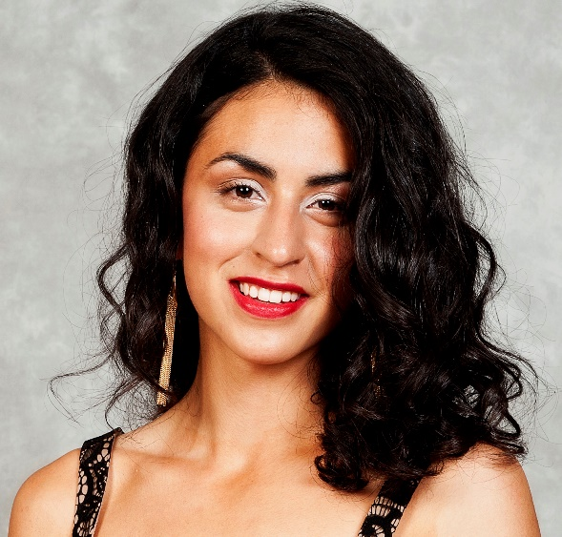
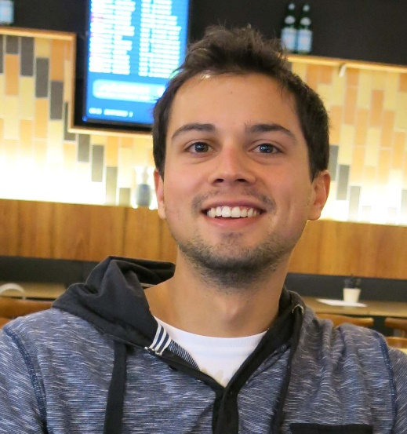
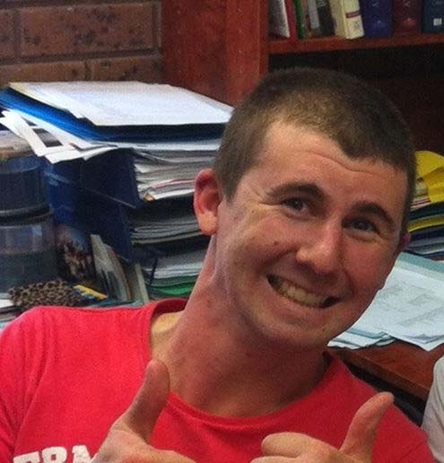
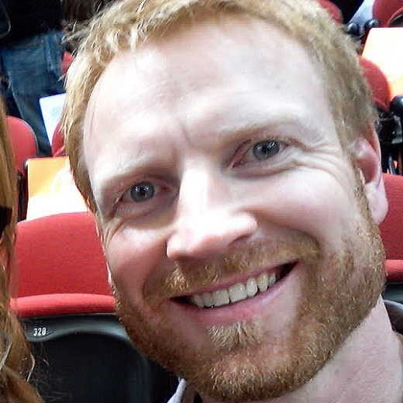
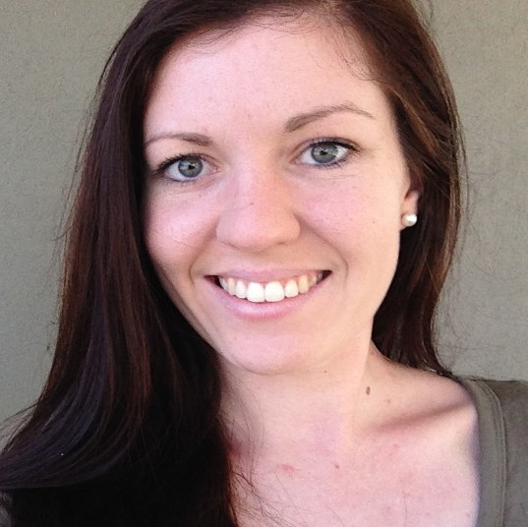
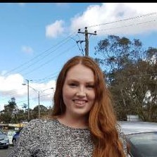
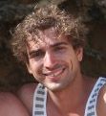
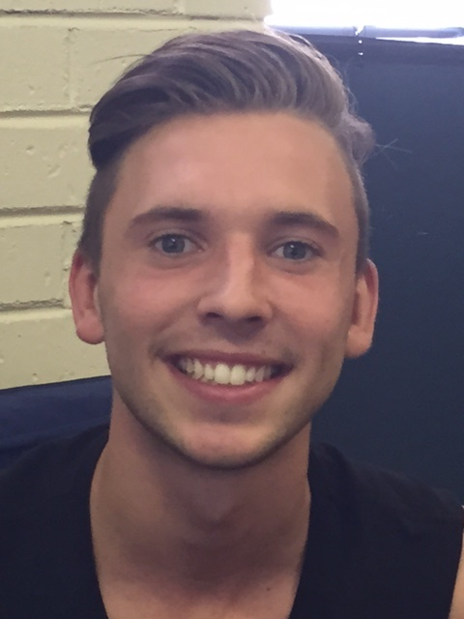
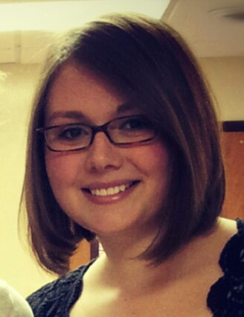
CCCVaT Emerging Leaders Program
The Emerging Leaders Program: 8 participants in the 4-year undergraduate/post-graduate program, 2 participants in the 2-year diploma program, & 1 participant in the non-accredited leadership development program.
The 2022 Annual Retreat: 11 participants, 4 facilitators over 3 days, focusing on the 'Heart' of a leader and a time to rest and refresh.
The 2021 Equipping Retreat: 35 Participants - 3 days, 5 different presenters. Topics: Surprise the World, Failing Well, Lifestyle Evangelism, Equipping Evangelists.
MyFriends Lifestyle Training (2022): 21 participants - 4-month intentional lifestyle disciple-making equipping and coaching process. Leadership focus to train and equip their community. In-progress, previous year training outcomes - 17 participants, 30 non-churched people reached, 8 people made a decision to follow Jesus, 5 discovery groups were formed & 1 baptism.
SHIFTm2M training - 7 Leaders participating - 9 X 1-day seminars over 12 months developing disciple-making capacity through a case study of Jesus' ministry focusing on His movement-building principles.

Slide 15

CCCVaT Prayer Ministry
Prayer Activities 2021:
100+ on weekly email prayer list
Intercessors to respond to urgent prayer needs.
Active participation in Prayer Groups for Schools/Inspire Chaplaincy, Melbourne Prayer Breakfast, Light FM Prayer.
Many answers to prayer including healing, provision, souls for the Kingdom.

Slide 16

CCCVaT Eleven88
Dance Ministry
Outreach Program for young people in government high schools and church youth groups via dance, body-image workshops, and faith communities.
- 1188 ‘Rise Up’ Summer Camp at CYC Phillip Island Adventure Resort February 2021 - 100 participants, over 50% responded to the Gospel message and gave their lives to Jesus.
- 1188 ‘The Journey Home’ Summer Camp at CYC Phillip Island Adventure Resort November 2021 - 150 Participants
- Soul Community - Over 30 participants including new believers and 10 in weekly leadership development programs.
- Weekly programs in 2 government schools with 15-20 students in each program.

Slide 17
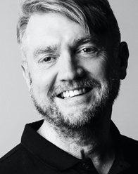
Church Planting
Conrad Parsons
Conrad was born in Sydney and grew up in Adelaide and in the Blue Mountains. He became a Christian in 1986 just before entering training as an evangelist. In 1991, he married Wendy in Bathurst. They moved to London in 1996 following the publication of his first book, Understanding Evangelists. In 2001, after launching an international ministry, Conrad visited Vanuatu on a three-week mission. His love of people in the Pacific Islands has continued since that visit. He has three ministry degrees including a Doctorate from Fuller Theological Seminary. He and Wendy, and their children, live in Melbourne. Conrad started coaching evangelists in 2001 and now continues to teach evangelists and trains leadership coaches globally. He will be responsible to identify, equip, mobilize, and providing ongoing support for pioneer church planters to plant church-planting churches, as well as catalyzing and facilitating existing churches in the movement to revitalize and plant new congregations and churches with CCCVaT.

Slide 18


The NCLS survey is designed to listen to the views of your leadership, attenders, and broader community to provide a picture of your church’s health and vitality. The results help you identify your strengths and provide processes to help you evaluate, make decisions and connect effectively with your community.
CCCVAT funded church participation in the survey for 2021

Slide 19


2021 AGM

Slide 20
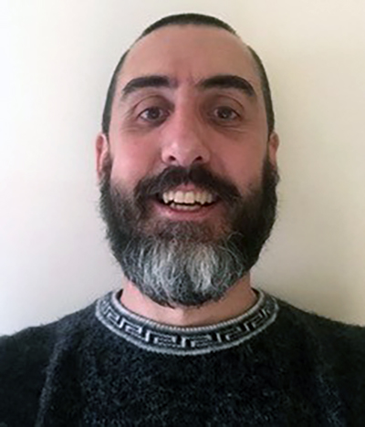
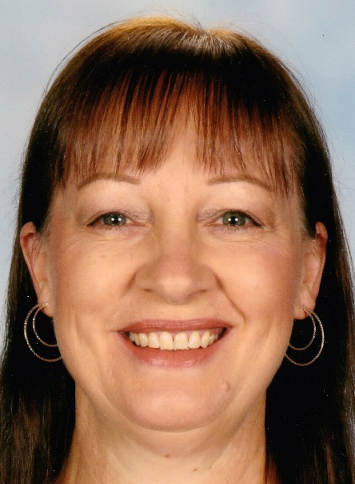
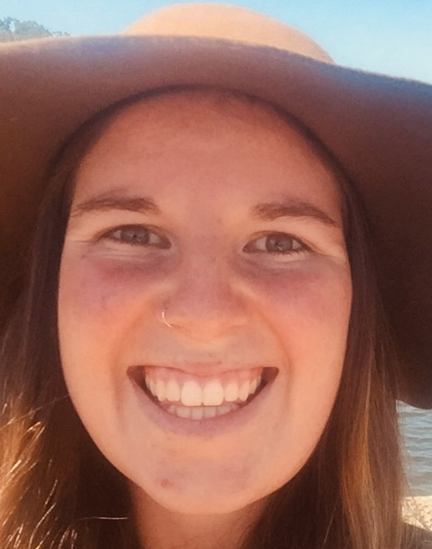
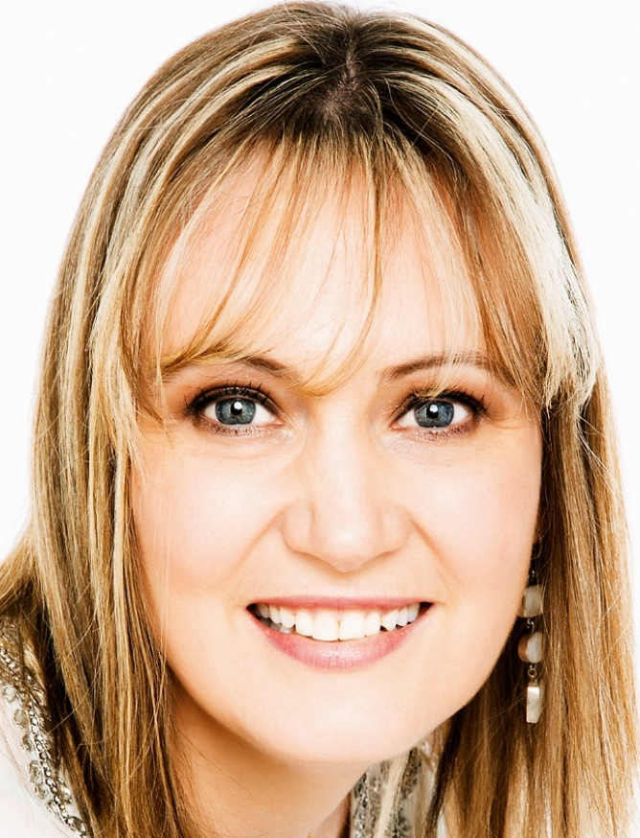
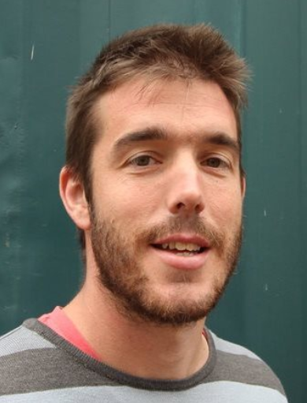
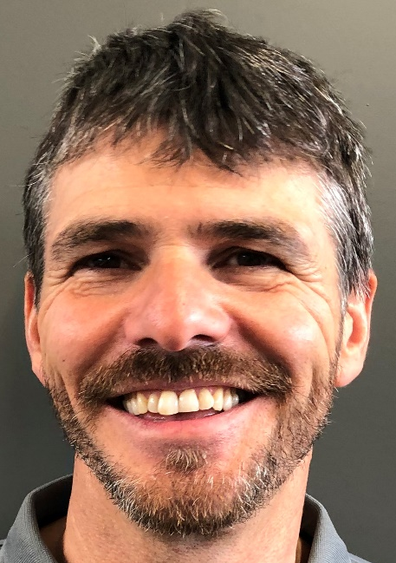
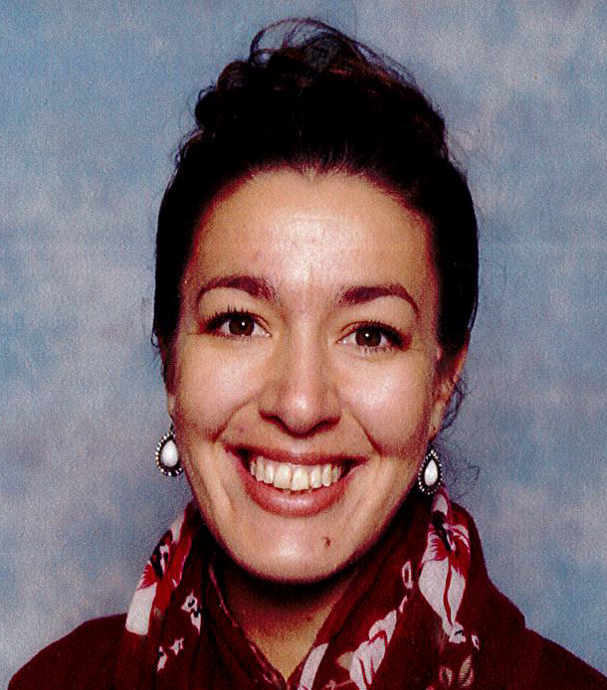
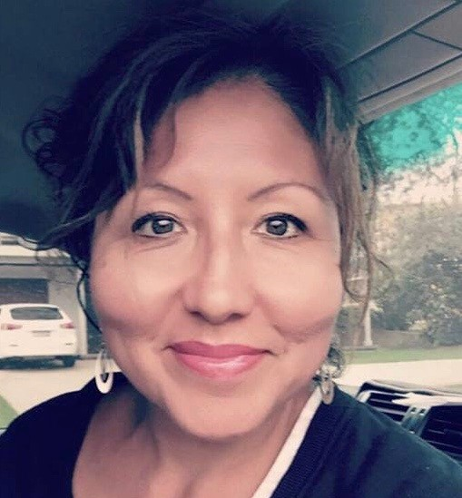
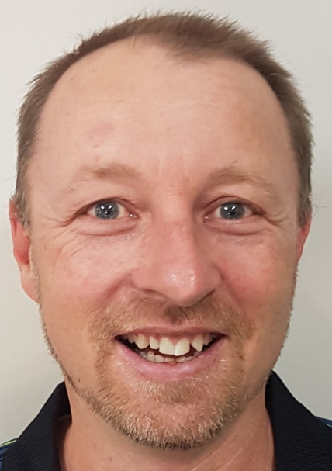
CCCVaT School
Support Services
1 | Anderson Creek PS
 | Robyn Mulholland
2 | Bayswater North PS
 | Alan Silverwood
3 | Bayswater South PS
 | Bronwyn Upton
4 | Victoria Road PS
 | Narelle Scampton
5 | Chum Creek PS
 | Marlee Nebauer
6 | Eastwood Primary and Deaf
 | Glennis Esson
7 | Great Ryrie PS
 | Alan Silverwood
8 | Mullum PS
 | Margaret Patching
9 | Launching Place PS
 | Chezelle Conroy
10 | Maffra Secondary College
 | Gerard Abdoo
11 | Neerim District SC
 | Claudia Correa
12 | Ringwood Secondary Col
 | Adam Bryant
12 | Ringwood Secondary Col
 | Jenni Farmilo
13 | The Basin Primary School
 | Richard Gordon
14 | Warragul North PS
 | Sheryn Cutler
15 | Wonga Park PS
 | Tony Van de Spek

