Slide 1
Affirming our Faith 21st Century Style
CCCVaT 2018 Conference
Dr David Wilson
Director
The Barnabas Connection

Slide 2
Introduction
Josh McDowell
Evidence that Demands a Verdict
More Evidence that Demands a Verdict
A reasoned approach to believing that God exists, Jesus rose from the dead, and the Bible is God’s revealed truth.
“God’s Word tells us we must “always be ready to give a defence to everyone who asks you for a reason for the hope that is in you” (1 Peter 3:15). This updated classic from Josh McDowell and Sean McDowell will give you the tools you need to do just that.”
1

Slide 3
Defending the Faith: Paul’s Example
Acts 22:1-2
“Brothers and fathers, listen now to my defense before you.” When they heard that he was addressing them in the Hebrew language, they became even quieter.
Defend?
Apologia
This is why I am doing this
Reasons for the way I believe
Often defaults into arguments for my thoughts on sexual ethics
And is perceived as quite attacking
2

Slide 4
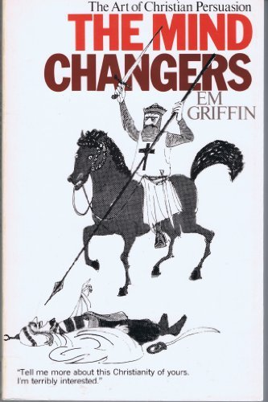
Defending the Faith: Paul’s Example
3

Slide 5
Defending the Faith: Peter’s Instruction
1 Peter 3
1 Peter 3:15-17
Set apart Christ as Lord in your hearts
Always be prepared
Opportunism
Flying the flag
Giving a reason
Precept—Principle—Person
Here’s why I live this way
With gentleness and respect
An invitation to conversational dialogue
Opposers will be shamed
Cognitive dissonance
4

Slide 6
Set Christ apart as Lord in your hearts…
5

Slide 7
Changing the world one conversation at a time
“We can take courage from the fact that many people are longing to be in conversation again. We are hungry for a chance to talk. People want to tell their story, and are willing to listen to yours. People want to talk about their concerns and struggles. Too many of us feel isolated, strange, or invisible. Conversation helps end that.”
Margaret Wheatley (American writer and Management Consultant) in ‘Turning to One Another: Simple Conversations to Restore Hope to the Future’
6

Slide 8
Advocating for the Faith
Advocate
Parakletos: to come alongside to encourage and enable
The main characteristics
Lifestyle
Relationship
Synergistic Enquiry
Cognitive Dissonance
7

Slide 9
In Conclusion
Philip Yancey
Dispensers of Grace
Pilgrims
Activists
Artists
Dr David R Wilson
davidroachwilson@gmail.com
8

